Slide 1

MECHINE LEARNING USING PYTHON

Slide 2
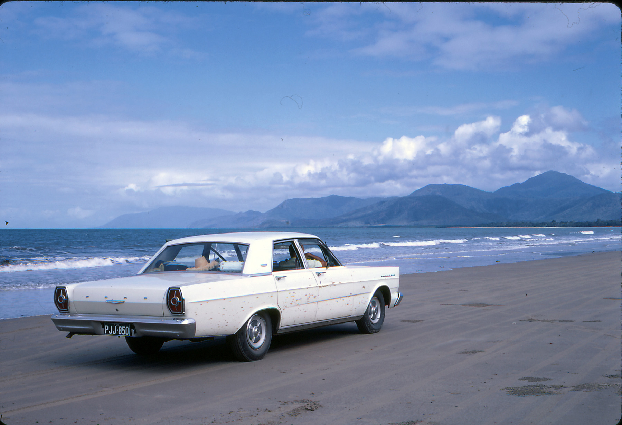
2nd SEMESTER Project-Work Details
PROJECT TOPIC NAME : : OLD CAR VALUE PREDICTOR
PROJECT BY :- Asit Ghosh
REG. NO. :- 200301120041
SUBMITTED TO : : Mamata Garanayak ma’am

Slide 3
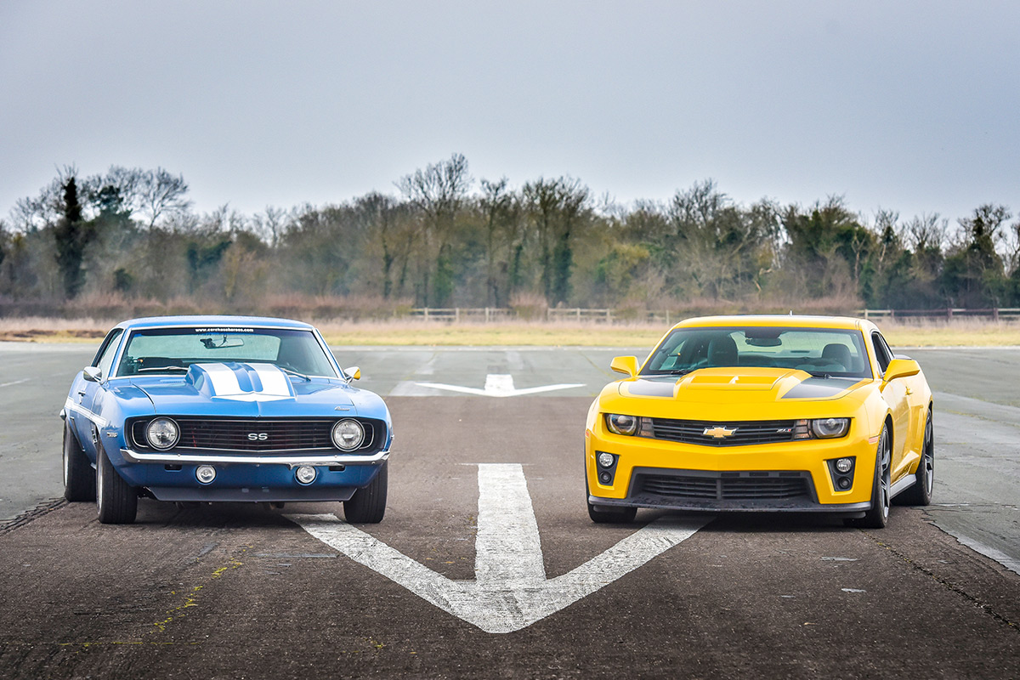
OLD CAR VALUE PREDICTOR
The points we need to discuss
The problems solved by using this project
Users of this project
Collection of data

Slide 4
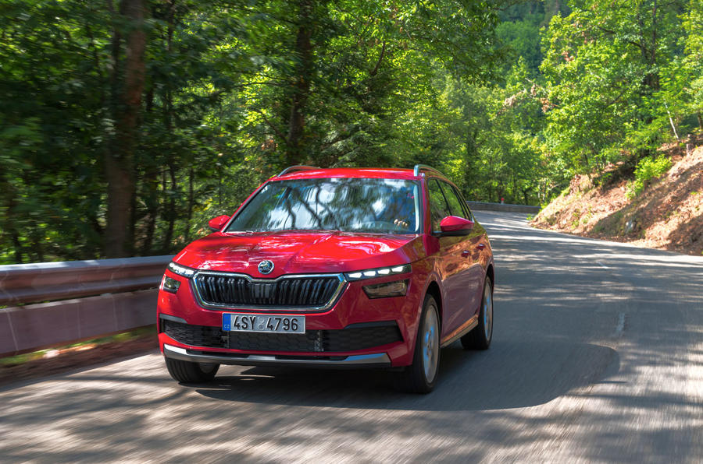

PROBLEMS
The prices of new cars in the industry is fixed by the manufacturer with some additional costs incurred by the Government in the form of taxes.
So, customers buying a new car can be assured of the money they invest to be worthy.
But due to the increased price of new cars and the incapability of customers to buy new cars due to the lack of funds, used cars sales are on a global increase .
There is a need for a used car price prediction system to effectively determine the worthiness of the car using a variety of features.
Even though there are websites that offers this service, their prediction method may not be the best.
Besides, different models and systems may contribute on predicting power for a used car’s actual market value.
It is important to know their actual market value while both buying and selling.

Slide 5
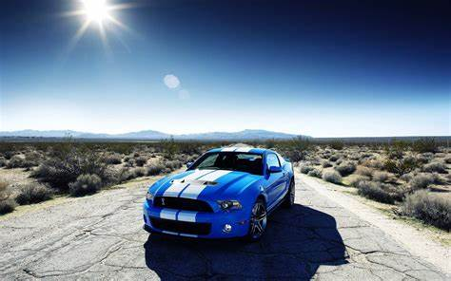
The Client
To be able to predict used cars market value can help both buyers and sellers.
Used car sellers (dealers): They are one of the biggest target group that can be interested in results of this study.
If used car sellers better understand what makes a car desirable, what the important features are for a used car, then they may consider this knowledge and offer a better service.

Slide 6
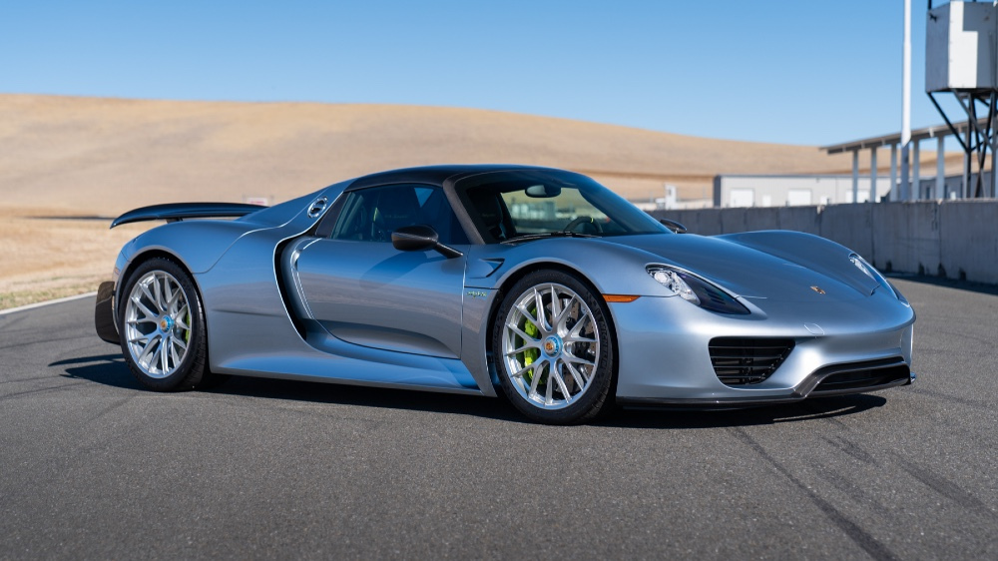
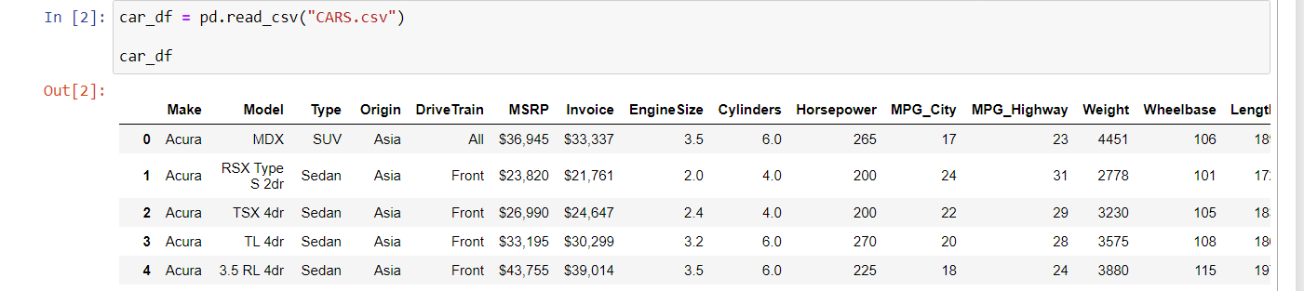
NEEDED DATA
The required data set downloaded from github.com
And the link was :-
https://www.kaggle.com/mjboilermaker/used-cars-prices-using-xgboost

Slide 7
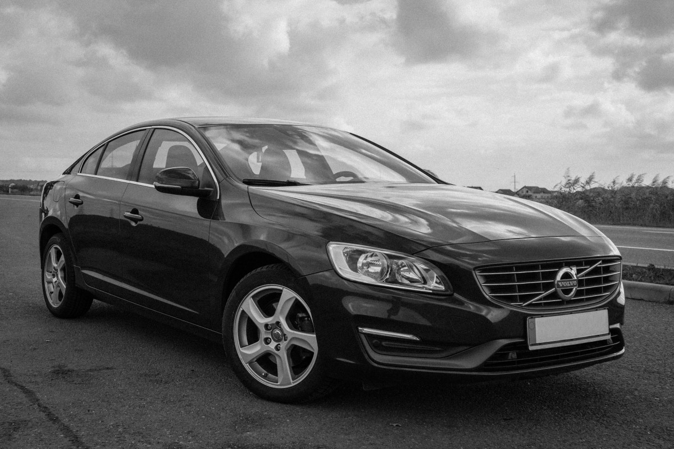
Steps we follow
Import required libraries -> check dataset ( if any issue is present ) -> solve the issues ->
data visualization -> create the model ->
predict the value

Slide 8
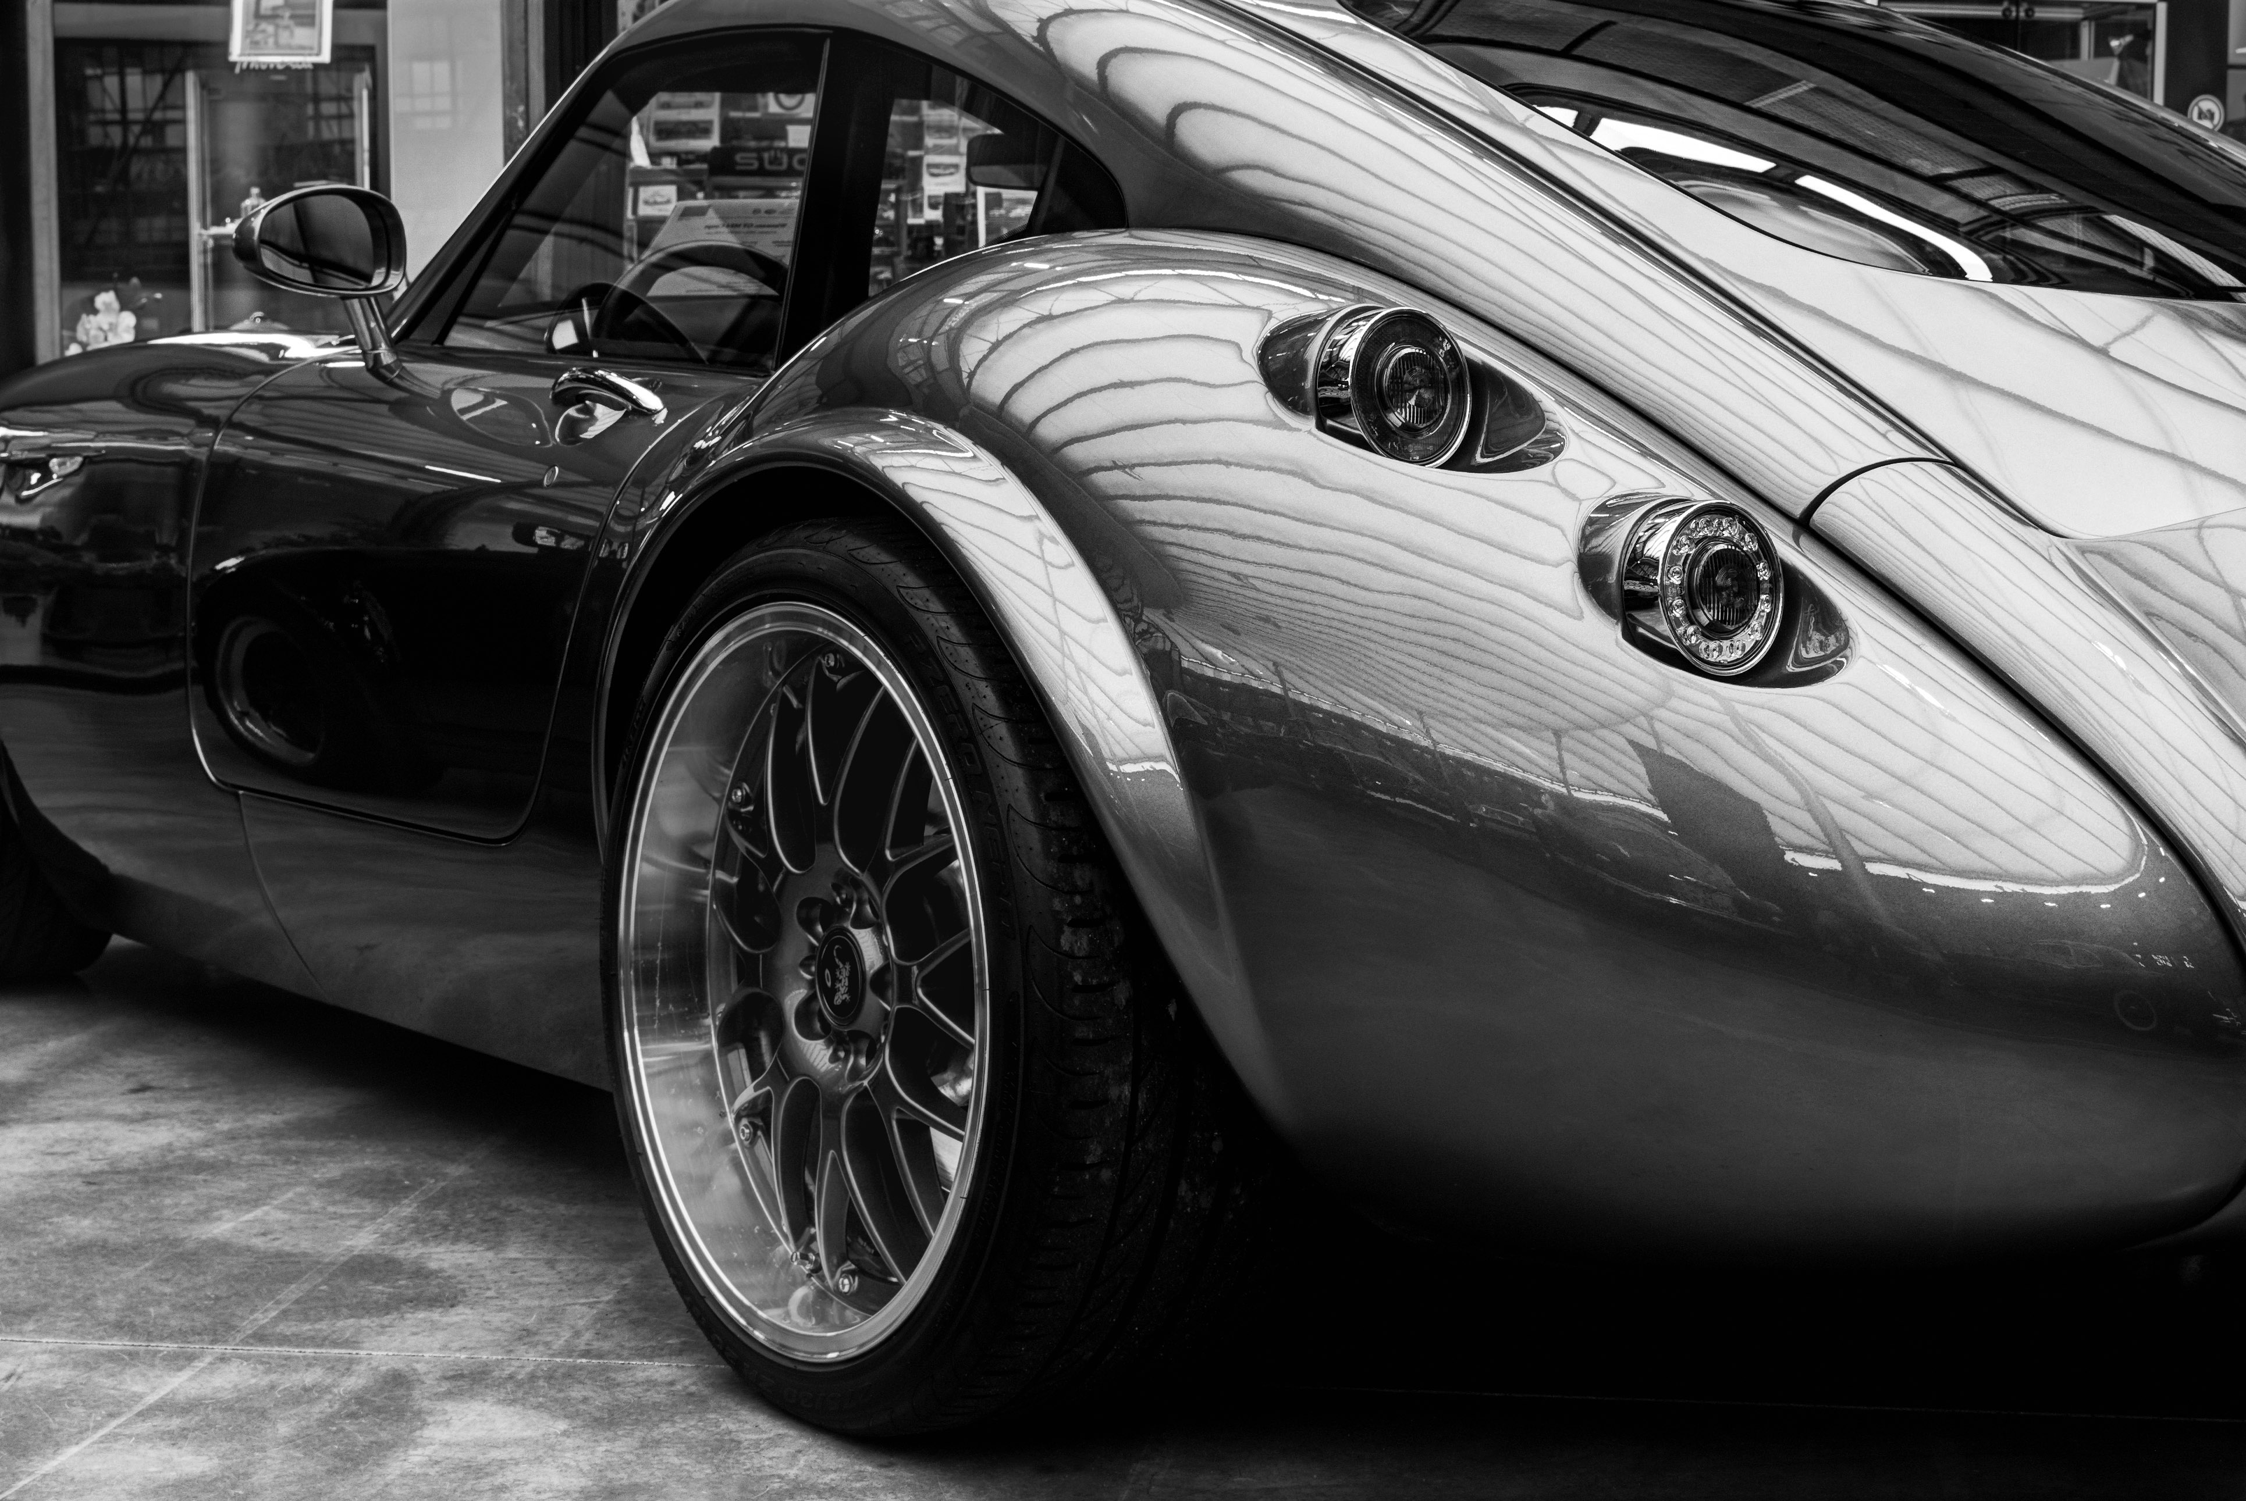
Check Dataset
Step_1 :- check is there any null value present or not.
Step_2 :- find out the symbols, which was present in dataset or
make some issue.
Step_3 :- convert string to integer which was required for
model formation.
SOLVE THE ISSUES
Remove the null values
Replace special characters and symbols
Make string to integer.

Slide 9

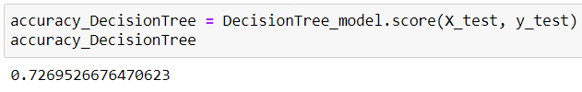
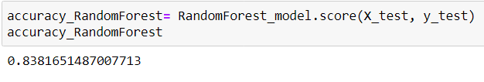
MODEL CREATION
There are so many different processes for build to the model;
I am using the following method to build the model
Linear Regression
Decision Tree
Random Forest Regressor
RESULT
Linear Regression
Decision Tree
Random Forest Regressor

Slide 10


